Slide 1
Deploying Windows 7
Lesson 3

Slide 2
Objectives
Understand enterprise deployments
Capture an image file
Modify an image file
Deploy an image file
Notes:
Outline the material you are going to cover in this lesson. Do not go into detail as each of these points will be expanded on in the lesson. You may also want to mention the Technology Skills that are being covered for the Certification exam also.

Slide 3
Understanding Enterprise Deployments
Careful planning is required and the following objectives must be considered:
  Create standardized computing environments
  Minimize user interaction at the workstation
  Ensure continued functionality of all hardware and software resources
  Minimize interruption of user productivity
Notes:
Emphasize why the planning process is so important and compare installing one computer to hundreds or thousands.

Slide 4
Steps to Deploy an Enterprise Workstation
Build a deployment share.
Perform a reference computer installation.
Capture an image of the reference computer.
Boot the target computers.
Apply the Windows 7 reference computer image.
Notes:
Expand on each of these general steps, and note that we will be talking about each step in more detail and look at the tools required to accomplish the steps.

Slide 5
Windows Deployment Tools
Windows 7 Automated Installation Kit
Microsoft Deployment Toolkit 2010
Windows Deployment Services
Notes:
Briefly introduce each tool.

Slide 6
Windows 7 Automated Installation Kit (AIK)
Primarily used by OEMs
OEMs deploy Windows 7 workstations two ways:
  Build-to-Plan (BTP)
  Build-to-Order (BTO)
Notes:
Explain what OEMs use deployment tools for and the two ways they are used.

Slide 7
Windows 7 AIK Tools
Windows System Image Manager
(Windows SIM)
ImageX.exe
Deployment Image Servicing and Management (DISM.exe)
Windows Pre-installation Environment (PE)
System Preparation (SysPrep.exe)
User State Migration Tool (USMT)
Notes:
Discuss the purpose of each tool.
Explain that the AIK is a free download from the MS website and it does not have to run on a Windows 7 computer.

Slide 8
Microsoft Deployment Toolkit (MDT) 2010
Superset of Windows 7 AIK for enterprise network deployments
Two types of deployments:
  Lite-touch installation (LTI)
  Zero-touch installation (ZTI)
Notes:
Review the differences in the 2 types of deployments and take note of the software that must be available on the network to support each one.

Slide 9
Enterprise Deployment Scenarios
New computer
Upgrade computer
Replace computer
Refresh computer
Notes:
Discuss the 4 Deployment Scenarios supported by MDT 2010.
Explain that MDT 2010 is also a free download from the MS website. Windows 7 AIK must be installed first before MDT 2010.

Slide 10
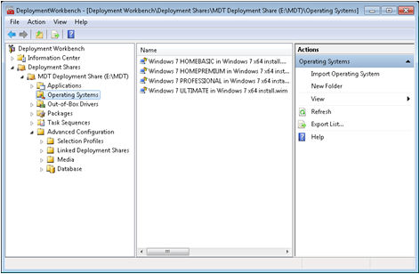
MDT 2010 Deployment Workbench Interface
Creates task sequences
Includes answer files and additional tasks
Can perform tasks before and after Windows 7 installation

Slide 11
Windows Deployment Services (WDS)
Included in Windows Server 2008
Used to deploy Windows imaging files over the network
Network must support:
  Dynamic Host Configuration Protocol (DHCP)
  Pre-boot Execution Environment (PXE)
Notes:
Explain the use of WDS and why it is useful in an enterprise deployment. Explain how it works and why the network must support DHCP and PXE. Also mention the discover image and using Windows PE.

Slide 12
Capturing image files

Slide 13
Image Files
Traditional files are sector-based.
Common extensions are .iso and .img.
Microsoft uses Windows Imaging files (.wim).
File-based images
Notes:
Review the differences between Sector-based and File-based images, and explain some of the advantages of File-based images.

Slide 14
Capturing Images
Depending on the environment
  Manual or automatic
  Simple to complex
  Only one image
  Many images for different users
Notes:
Explain that depending on the size and complexity of the environment, the process can be manual or automatic, and simple to complex. Sometimes only one or two different images are required, but sometimes dozens or more. You may want to automate the process if many images are needed.

Slide 15
Capturing an Image Manually Using ImageX.exe
Install the reference computer
Prepare the reference computer (SysPrep)
sysprep /generalize /oobe
Create a Windows PE Boot disk
Capture the image file
Imagex.exe /capture c: d:\win7.wim “Win7” /verify
Notes:
Explain the 4 steps to manually capture an image file. Describe the syntax of each command (descriptions in textbook).

Slide 16
Using Windows SIM
Creates answer files to streamline the process of creating multiple images
Provides responses to prompts that appear during Windows 7 installation
  Partition and format disks
  Install device drivers
  Configure Windows 7 parameters
Notes:
Explain what answer files are used for.

Slide 17
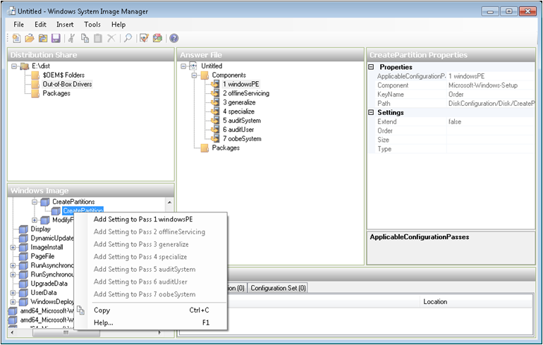
Answer File Settings
Notes:
Discuss configuration passes and that different elements get added to specific configuration passes.
You can also add device drivers and software packages to the distribution share that you want installed during the setup process.
Validate the answer file and correct any discrepancies.
Create the configuration set: includes all files added to the distribution folder along with the answer file.

Slide 18
Applying an Answer File
Copy the configuration set files to a removable medium (CD, DVD, or USB flash)
Boot from Windows 7 installation DVD
Insert removable media containing answer file
Windows setup scans for answer file
Can also start the installation from a Windows PE command prompt and specify the answer file

Slide 19
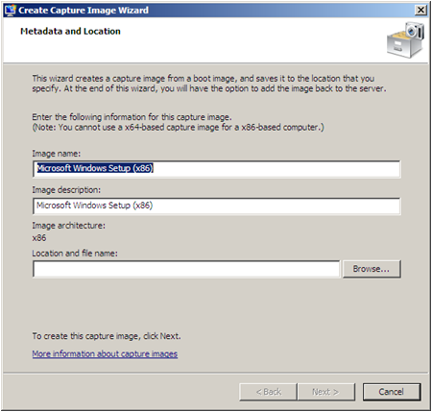
Capturing an Image Using WDS
Automates the capture process
Wizard-based
Create capture image and upload it to WDS server
Can be deployed immediately

Slide 20
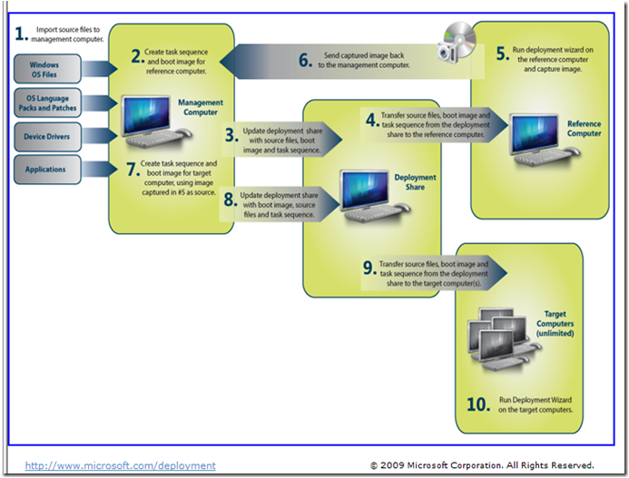
Capturing an Image Using MDT 2010
Notes:
Use the image above to describe the steps of creating an image using MDT 2010.

Slide 21
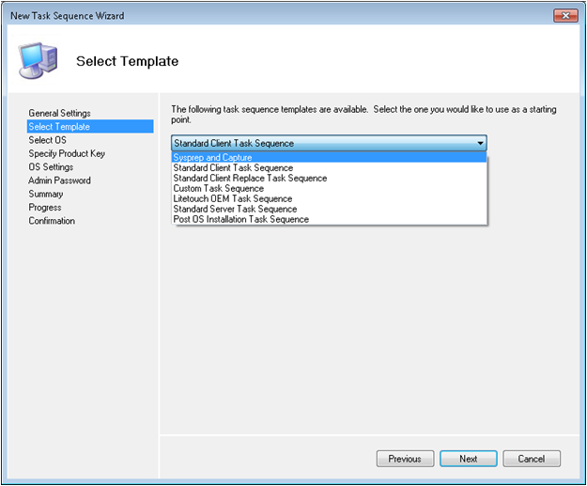
The New Task Sequence Wizard
Notes:
Explain that although this can be a complicated process, the wizard and the task templates, can make it a very easy process. Just follow the steps.

Slide 22
Introducing Deployment Image Servicing and Management (DISM.exe)
Used to modify image files while offline
  Add device drivers
  Add language packs
  Add packaged updates
  Enable or disable operating system features
  Append a volume image to a workstation image
  Combine multiple images in a single Windows Imaging file
Notes:
Describe what DISM is used for and what the basic steps are to modify an image.

Slide 23
Deploying Image Files

Slide 24
Understanding Image Types
Using thick images
Using thin images
Using hybrid images
Notes:
Discuss the different types of images and when each one might be used.

Slide 25
Deploying Images Manually Using ImageX.exe
Create a disk partition (diskpart)
  Create partition primary
  Format fs=NTFS label=“New Partition” quick
  Assign letter=c
Access the install image
Apply the install image
  Imagex /apply z:\images\win7.wim 1 c:
Apply boot files
  Bcdboot c:\windows
Notes:
Describe how file-based images need the hard disk to be prepared before writing the image to the disk. We use diskpart.
Describe the steps to deploy the image, explaining the command syntax

Slide 26
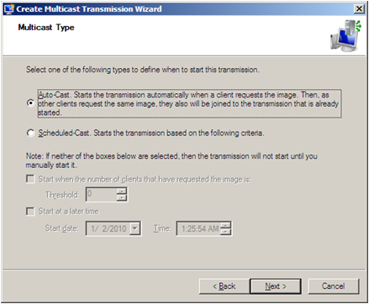
Deploying Images Using WDS
Can deploy images created with WDS, Windows 7 AIK, or MDT 2010
  Requires a boot image
Multicasting
with WDS
Notes:
Explain that WDS can be used as a self-contained solution for both creating and deploying image files, or it can be used to deploy images created with Windows 7 AIK or MDT 2010.
Define multicasting and explain how multicasting reduces network traffic. Point to the options on the dialog box to change the way the multicasting will start.

Slide 27
Deploying Images Using MDT 2010
Similar procedure to deploy as to create
Add images to deployment share
Create task sequences to apply images to target computers
Thick images – Simple task sequences
Thin or Hybrid – More scripting required
Notes:
Review points and expand where necessary. Look forward to next slide to review the entire MDT process, in particular the deployment part.

Slide 28

Deploying Images Using MDT 2010 (cont.)
Notes:
Review the deployment half of this chart.

Slide 29
Performing an LTI Deployment
Someone at the target computer has to:
  Boot the computer
  Run the Deployment Wizard
  Select task sequence to install Windows 7
  More interaction may be required depending on the task sequence
Less interaction at workstation requires more preparation for deployment and vice versa

Slide 30
Using System Center Configuration Manager 2007 (SCCM)
Required for Zero-touch installation deployment (ZTI)
Complex network management product
Can be used to capture and deploy image files in the same basic sequence as LTI
Uses SCCM tools instead of Deployment Workbench

Slide 31
Using System Center Configuration Manager 2007 (SCCM) (cont.)
Only use this product for deployment of images if you are already using it
Requires considerable planning because it has many components and options
Stores data in a SQL database
Requires client agent on each computer it manages
Very expensive product to run, but very powerful

Slide 32
Deploying Windows 7 with SCCM 2007
Basic steps are the same as for LTI deployment
SCCM enables you to configure every aspect of the deployment in great detail
Completely scalable to any size network
Can create multiple distribution points
Bare-metal computers can be added to the SCCM database
Allows workstations to connect to SCCM/MDT server and execute the task sequence that deploys workstation configuration

Slide 33
Skills Summary
The objectives of a large-scale Windows 7 deployment include:
  Creation of standardized computing environments
  Minimized user interaction at the workstation

Slide 34
Skills Summary
The basic steps of a workstation deployment are:
  Build a deployment share
  Perform a reference computer installation
  Capture an image of the reference computer
  Boot the target computers
  Apply the Windows 7 reference computer image

Slide 35
Skills Summary (cont.)
Tools used to deploy workstations:
  Windows 7 Automated Installation Kit (AIK)
  Windows Deployment Services (WDS)
  Microsoft Deployment Toolkit (MDT) 2010
Create answer files using the Windows SIM utility, to automate the Windows 7 installation process.
Modify your image file with DISM.exe tool

Slide 36
Skills Summary (cont.)
Zero-touch installation (ZTI) deployment requires System Center Configuration Manager 2007 installed on your network.
SCCM 2007 is a comprehensive network management product that, among many other things, can distribute software to the computers on your network.

